Slide 1
Invoice Currency and Frequency of Import Transaction
Kazunobu Hayakawa (Institute of Developing Economies)
Nuttawut Laksanapanyakul (Thailand Development Research Institute)
Taiyo Yoshimi (Nanzan University)

Slide 2
Outline
Motivation
Major Findings
The Model
Data
Invoice Currency, Import Frequency and Value per Shipment
Benefits of HCI
Conclusion

Slide 3
1. Motivation
What is the benefits of running an international currency?
  We examine this from the view of invoice currency in imports.
Invoice currency and exchange-rate risk
  Home currency invoicing (HCI): No ER risk for home importers.
  Foreign currency invoicing (FCI): Importers manage ER risk with some costs.
HCI vs FCI
  HCI: ER risk doesn’t exist.
  FCI: Importers have to pay costs of ER risk management, but importing cost will become cheaper if the foreign invoice currency will be discounted enough.

Slide 4
What we do
We present a model of endogenous choice of import frequency and invoice currency.
Based on the model, we infer the benefits of HCI.
  The benefits are represented by fixed costs of ER risk management under FCI in the model, and inferred with observable information.
  A highly disaggregated dataset on Thai imports: company code, transaction date, trade value and quantity, invoice currency in each transaction, etc…
We also examine the relation between invoice currency, import frequency, and value per shipment.

Slide 5
2. Major Findings
Those benefits of average Thai importer range between 7.3% (1,500USD) and 17.1% (3,600USD) of one-time shipment value.
Those benefits become larger when
  Turnover Share of the export country currency is lower,
  or the export country is one of partners of Thailand’s RTA.
Import frequency is higher and the value per shipment is smaller for products invoiced in customers’ (importers’) currency than those not priced in it.
  HCI is associated with just-in-time orders.

Slide 6
Literature
Trade frequency
  Kropf and Sauré (2014) infer fixed costs per shipment, and examine determinants of shipment frequency and the value per shipment.
  Bekes et al. (2014) introduce uncertainty into consideration.
Choice of invoice currency
  Goldberg and Tille (2009) examine the choice of the invoice currency through bargaining btw exporters and importers.
  Gopinath et al. (2010) construct a model where importer choose the invoice currency.
We combine these two literature to infer the benefits of HCI.

Slide 7
3. The Model
Partial equilibrium model a la Kropf and Sauré (2014) with infinite number of countries.
Two differences:
  Importers optimize in our model.
  Invoice currencies are endogenously determined.
Agents
  Representative household
  Final-good producers (importers of intermediate inputs)
  Financial institution (implicit)
  Intermediate-good producer (implicit)

Slide 8
Structure (simplified)
Country
Bank(s)
House
Final
Final
Final
Intermediate
Country
Country
Bank(s)
Bank(s)
House
House
Final
Final
Final
Final
Final
Final
Intermediate
Intermediate

Slide 9

3.1. Representative Household
Preference
  $u=c$
  $c≡{\left[\int_{0}^{1}{c_{i}^{\frac{θ−1}{θ}}di}\right]}^{\frac{θ}{θ−1}}, 1<θ<∞$
Demand and Price Index
  $c_{i}={\left(\frac{p_{i}}{P}\right)}^{−θ}\frac{Y}{P}$
  $P≡{\left[\int_{0}^{1}{p_{i}^{1−θ}di}\right]}^{\frac{1}{1−θ}}$

Slide 10
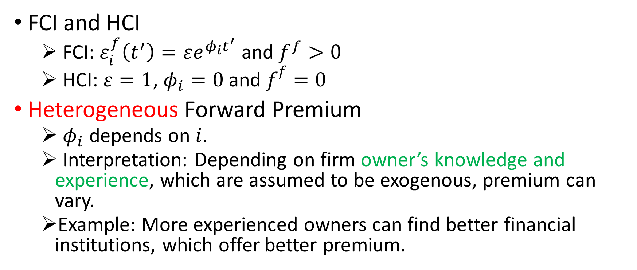
3.2. Forward Exchange Rates
FCI and HCI
  FCI: $ε_{i}^{f}\left(t^{′}\right)=εe^{φ_{i}t^{′}} \text{and} f^{f}>0$
  HCI: $ε=1$, $φ_{i}=0$ and $f^{f}=0$
Heterogeneous Forward Premium
  $φ_{i}$ depends on $i$.
  Interpretation: Depending on firm owner’s knowledge and experience, which are assumed to be exogenous, premium can vary.
  Example: More experienced owners can find better financial institutions, which offer better premium.

Slide 11
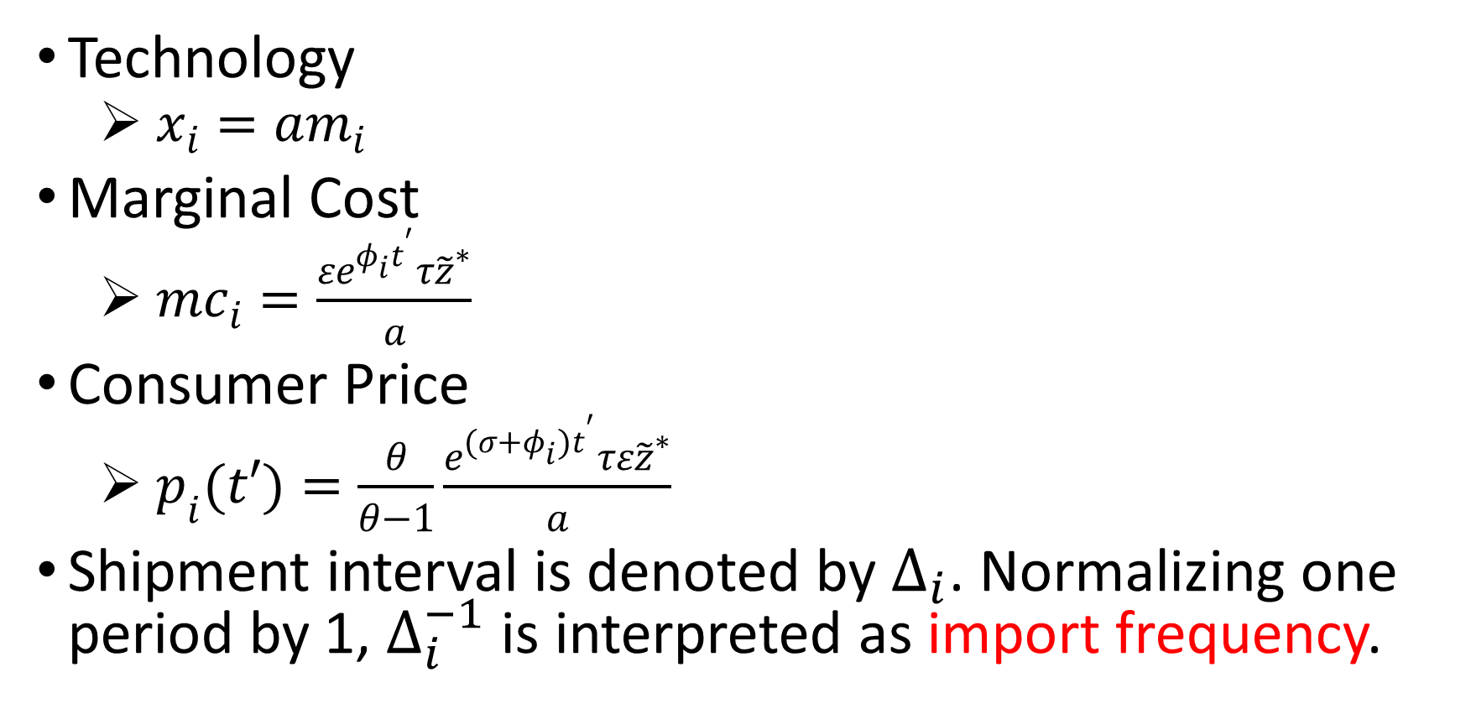
3.3. Final-good Producers
Technology
  $x_{i}=am_{i}$
Marginal Cost
  ${mc}_{i}=\frac{εe^{φ_{i}t^{′}}τ{\tilde{z}}^{∗}}{a}$
Consumer Price
  $p_{i}(t′)=\frac{θ}{θ−1}\frac{e^{(σ+φ_{i})t^{′}}τε{\tilde{z}}^{∗}}{a}$
Shipment interval is denoted by $∆_{i}$. Normalizing one period by 1, $∆_{i}^{−1}$ is interpreted as import frequency.

Slide 12
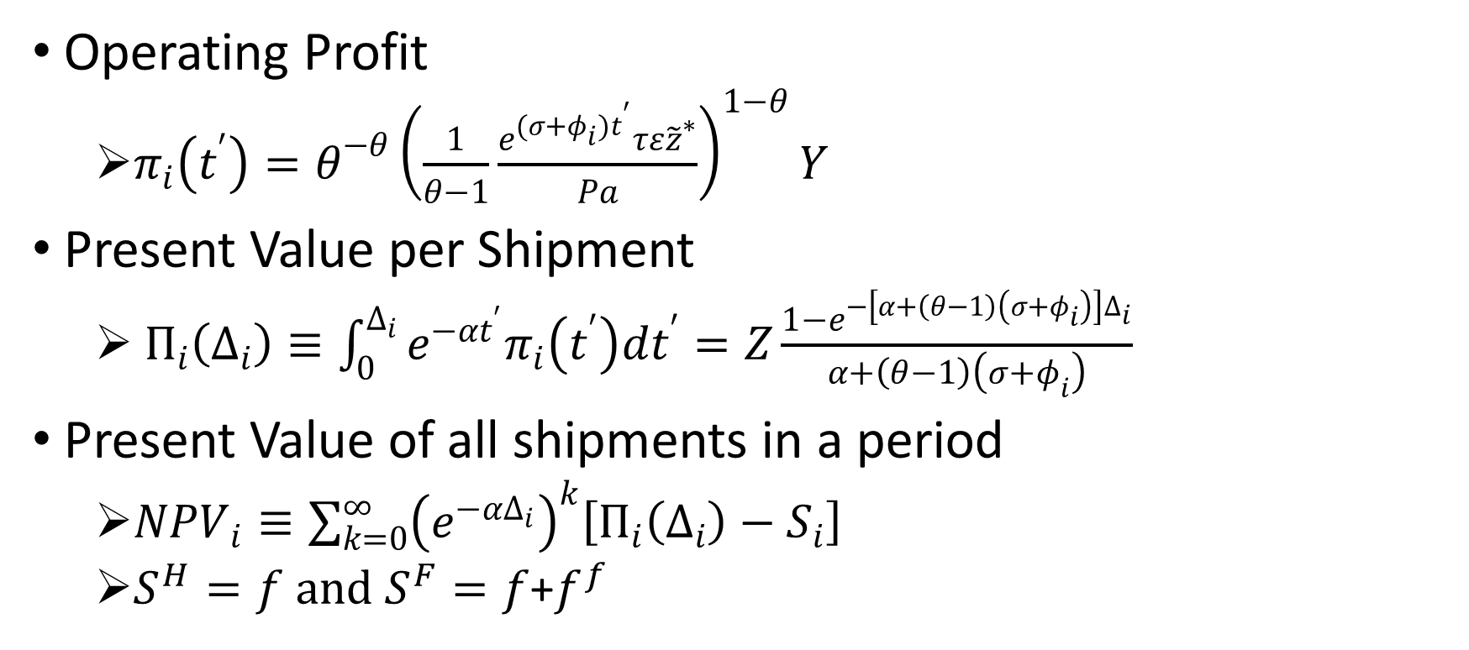
Profits
Operating Profit
  $π_{i}\left(t^{′}\right)=θ^{−θ}{\left(\frac{1}{θ−1}\frac{e^{(σ+φ_{i})t^{′}}τε{\tilde{z}}^{∗}}{Pa}\right)}^{1−θ}Y$
Present Value per Shipment
  $Π_{i}\left(∆_{i}\right)≡\int_{0}^{∆_{i}}{e^{−αt^{′}}π_{i}\left(t^{′}\right)dt^{′}}=Z\frac{1−e^{−\left[α+\left(θ−1\right)\left(σ+φ_{i}\right)\right]∆_{i}}}{α+\left(θ−1\right)\left(σ+φ_{i}\right)}$
Present Value of all shipments in a period
  ${NPV}_{i}≡\sum_{k=0}^{∞}{{\left(e^{−αΔ_{i}}\right)}^{k}\left[Π_{i}\left(∆_{i}\right)−S_{i}\right]}$
  $S^{H}=f and S^{F}=f$+$f^{f}$

Slide 13
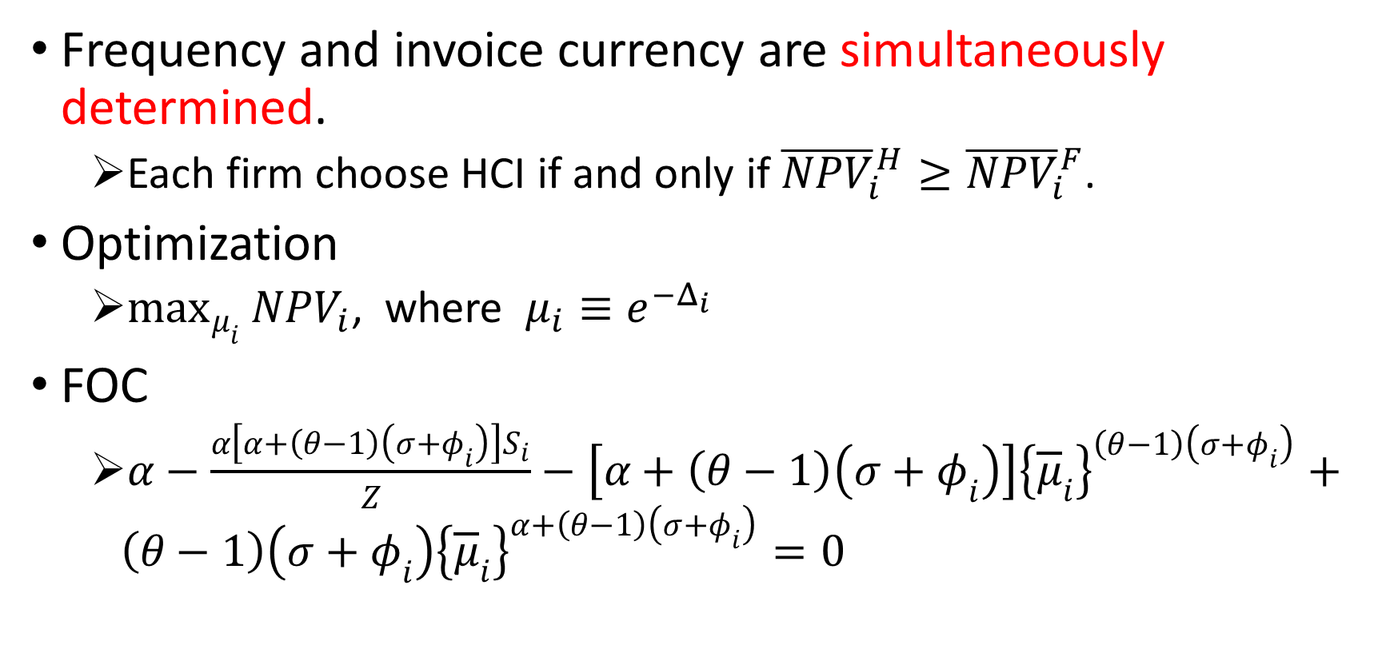
3.4. Frequency and Value per Shipment
Frequency and invoice currency are simultaneously determined.
  Each firm choose HCI if and only if ${\overline{NPV}}_{i}^{H}≥{\overline{NPV}}_{i}^{F}$.
Optimization
  $\max_{μ_{i}}{{NPV}_{i}}$, where $μ_{i}≡e^{−Δ_{i}}$
FOC
  $α−\frac{α\left[α+\left(θ−1\right)\left(σ+φ_{i}\right)\right]S_{i}}{Z}−\left[α+\left(θ−1\right)\left(σ+φ_{i}\right)\right]{\left\{{\overline{μ}}_{i}\right\}}^{\left(θ−1\right)\left(σ+φ_{i}\right)}+\left(θ−1\right)\left(σ+φ_{i}\right){\left\{{\overline{μ}}_{i}\right\}}^{α+\left(θ−1\right)\left(σ+φ_{i}\right)}=0$

Slide 14
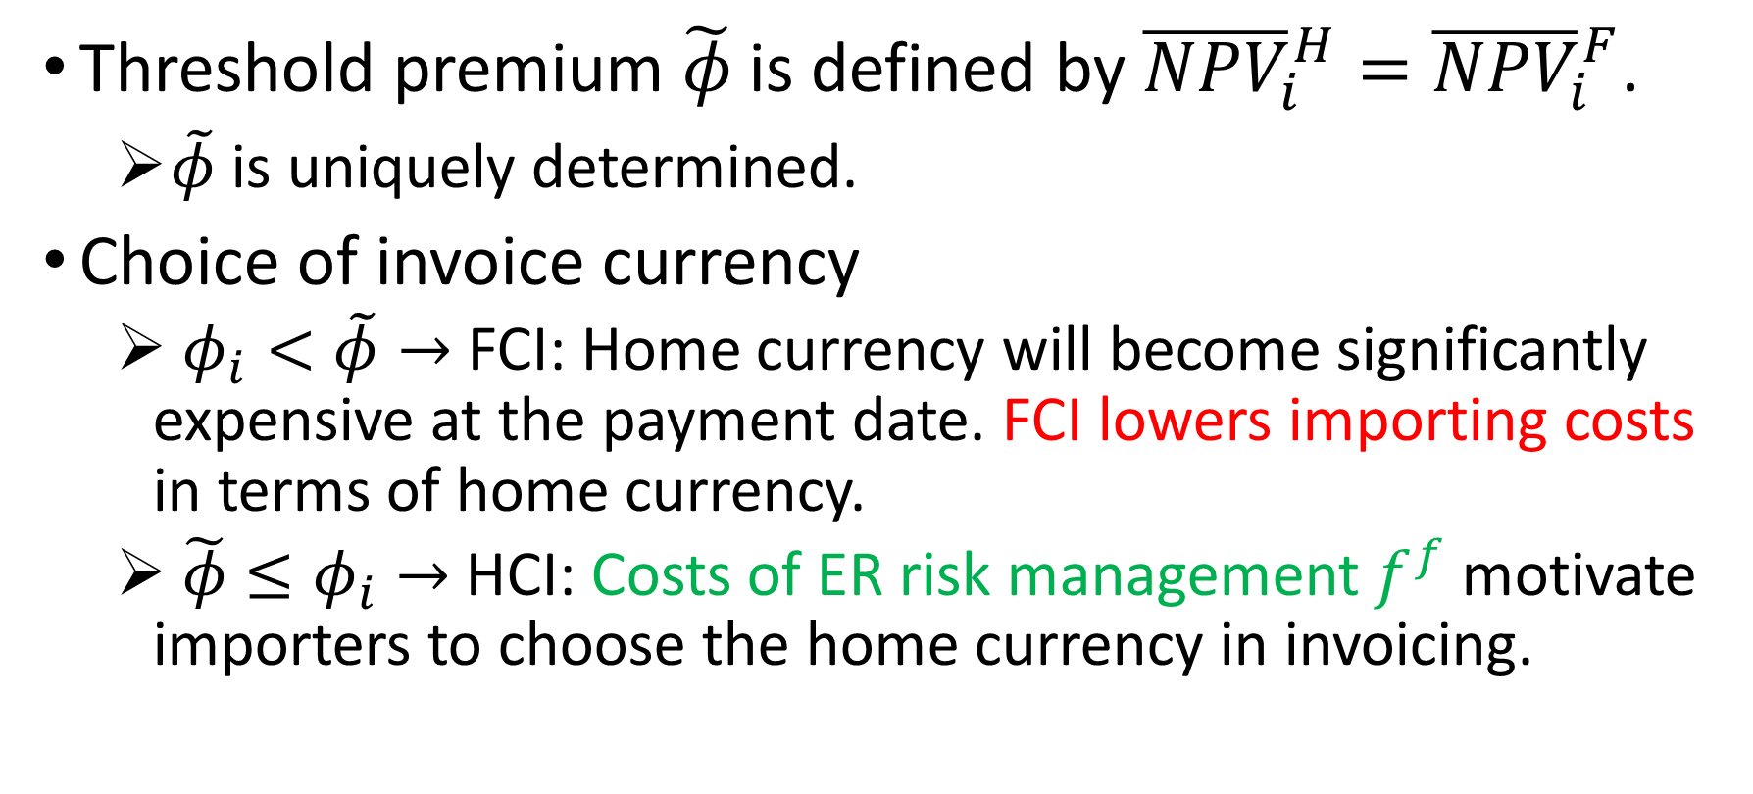
Threshold Forward Premium
Threshold premium $\tilde{φ}$ is defined by ${\overline{NPV}}_{i}^{H}={\overline{NPV}}_{i}^{F}$.
    $\tilde{φ}$ is uniquely determined.
Choice of invoice currency
  $φ_{i}<\tilde{φ}→$ FCI: Home currency will become significantly expensive at the payment date. FCI lowers importing costs in terms of home currency.
  $\tilde{φ}≤φ_{i}→$ HCI: Costs of ER risk management $f^{f}$ motivate importers to choose the home currency in invoicing.

Slide 15
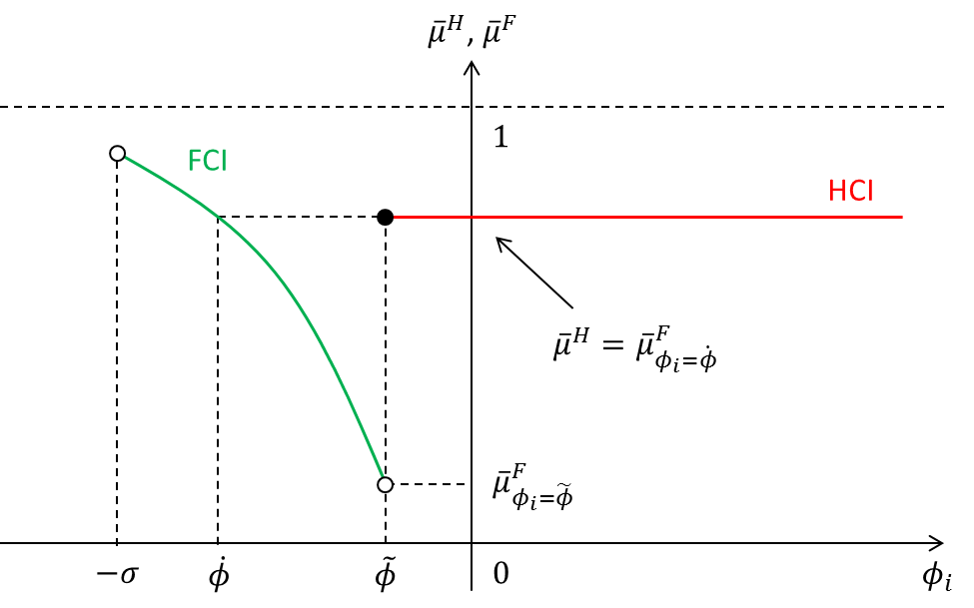
Forward Premium and Import Frequency

Slide 16

Value per Shipment
Value per shipment in terms of the home currency
  ${\overline{q}}_{i}≡\int_{0}^{{\overline{∆}}_{i}}{ετ{\tilde{z}}^{∗}\frac{c_{i}(t^{′})}{a}dt^{′}}=Z\frac{θ−1}{θ}\frac{1}{σ+φ_{i}}\left\{1−{\left({\overline{μ}}_{i}\right)}^{θ(σ+φ_{i})}\right\}$

Slide 17
Propositions
Proposition 1: Import frequency of FCI importers is lower than that of HCI ones around the cutoff forward premium, which is more likely when the fixed cost of exchange-rate risk management is larger.
Proposition 2: The existence of the fixed cost of exchange-rate risk management increases the value per shipment of FCI importers over that of HCI importers.

Slide 18
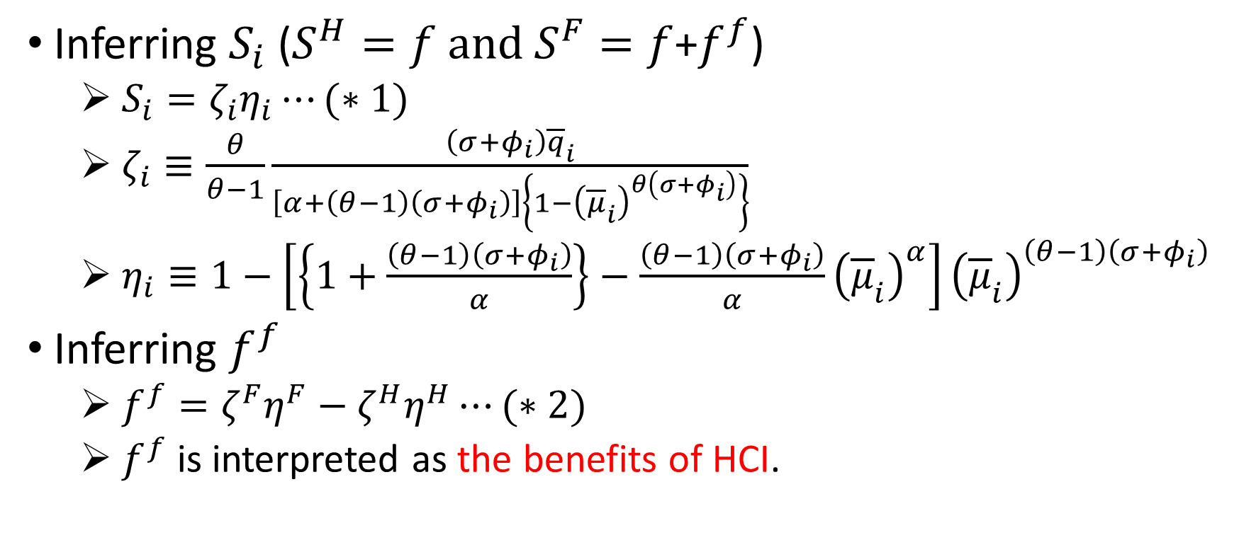
3.5. Benefits of HCI
Inferring $S_{i}$ ($S^{H}=f and S^{F}=f$+$f^{f}$)
  $S_{i}=ζ_{i}η_{i}⋯(∗1)$
  $ζ_{i}≡\frac{θ}{θ−1}\frac{\left(σ+φ_{i}\right){\overline{q}}_{i}}{\left[α+\left(θ−1\right)\left(σ+φ_{i}\right)\right]\left\{1−{\left({\overline{μ}}_{i}\right)}^{θ\left(σ+φ_{i}\right)}\right\}}$
  $η_{i}≡1−\left[\left\{1+\frac{\left(θ−1\right)\left(σ+φ_{i}\right)}{α}\right\}−\frac{\left(θ−1\right)\left(σ+φ_{i}\right)}{α}{\left({\overline{μ}}_{i}\right)}^{α}\right]{\left({\overline{μ}}_{i}\right)}^{\left(θ−1\right)\left(σ+φ_{i}\right)}$
Inferring $f^{f}$
  $f^{f}=ζ^{F}η^{F}−ζ^{H}η^{H}⋯(∗2)$
  $f^{f}$ is interpreted as the benefits of HCI.

Slide 19
4. Data
Transaction-level import data from 2007 to 2011, which covers all commodity imports in Thailand.
Customs clearing date, HS eight-digit code, export country, import firm ID, invoice currency, import values in Thai Baht (THB), import quantity, and quantity unit.

Slide 20
Figure 2. Sample Distribution of Number of Shipments per Year

Slide 21
Figure 3. Sample Distribution of Average Import Values per Shipment

Slide 22
Table 1. The Decomposition of Import Transactions According to Invoice Currencies

Slide 23
Table 4. Basic Statistics for Import Frequency and Imports per Shipment by Invoice Currency

Slide 24
Data Overview
More than a half of all import transactions have only one shipment per year.
Distribution of average imports per shipment seems to follow the log-normal distribution.
Approximately 60% and 80% of import in Thailand are invoiced in the vehicle currency in terms of the number of transactions and of values, respectively.

Slide 25
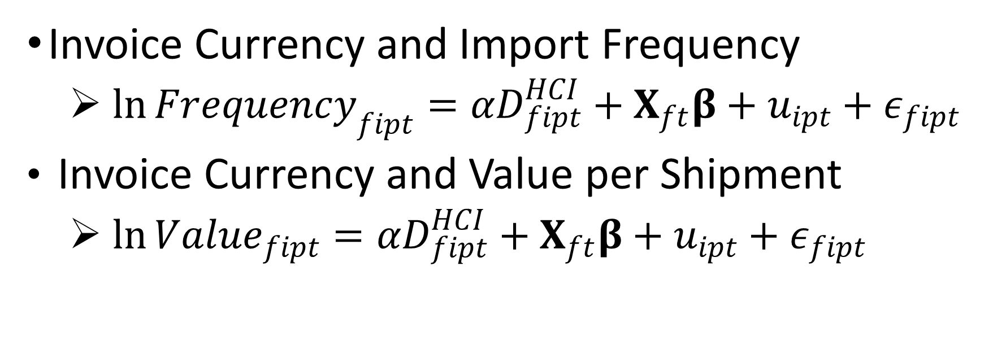
5. Invoice Currency, Import Frequency and Value per Shipment
Invoice Currency and Import Frequency
  $\ln{{Frequency}_{fipt}}=αD_{fipt}^{HCI}+X_{ft}β+u_{ipt}+ε_{fipt}$
Invoice Currency and Value per Shipment
  $\ln{{Value}_{fipt}}=αD_{fipt}^{HCI}+X_{ft}β+u_{ipt}+ε_{fipt}$

Slide 26
Table 7. Determinants of Import Frequency

Slide 27
Table 8. Robustness Checks on Import Frequency

Slide 28
Table 9. Determinants of Average Import Values per Shipment

Slide 29
Invoice Currency, Import Frequency and Value per Shipment
Invoice Currency and Import Frequency
  Frequency is higher for HCI than FCI.
  Proposition 1 provides a rationale.
Invoice Currency and Value per Shipment
  Value per shipment is smaller for HCI than FCI.
  Proposition 2 provides a rationale.
Just-in-time orders are observed for HCI.

Slide 30
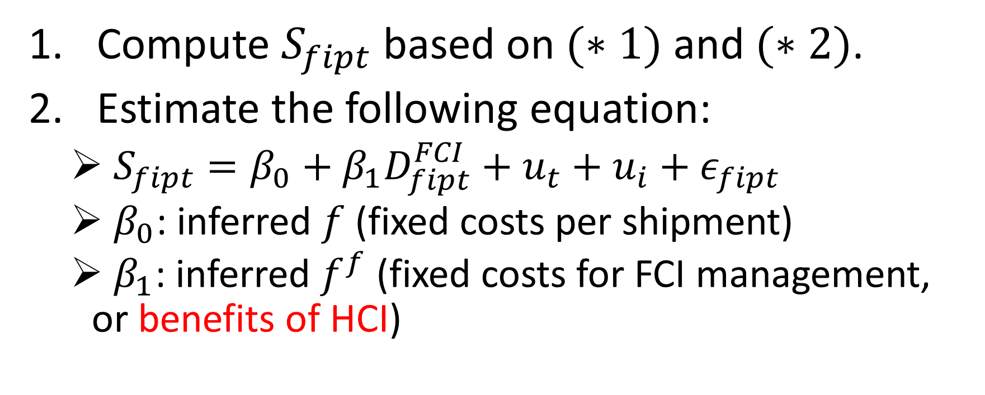
6. Benefits of HCI
Compute $S_{fipt}$ based on $(∗1)$ and $(∗2)$.
Estimate the following equation:
  $S_{fipt}=β_{0}+β_{1}D_{fipt}^{FCI}+u_{t}+u_{i}+ε_{fipt}$
  $β_{0}$: inferred $f$ (fixed costs per shipment)
  $β_{1}$: inferred $f^{f}$ (fixed costs for FCI management, or benefits of HCI)

Slide 31
Table 10. Fixed Costs for FCI Management

Slide 32
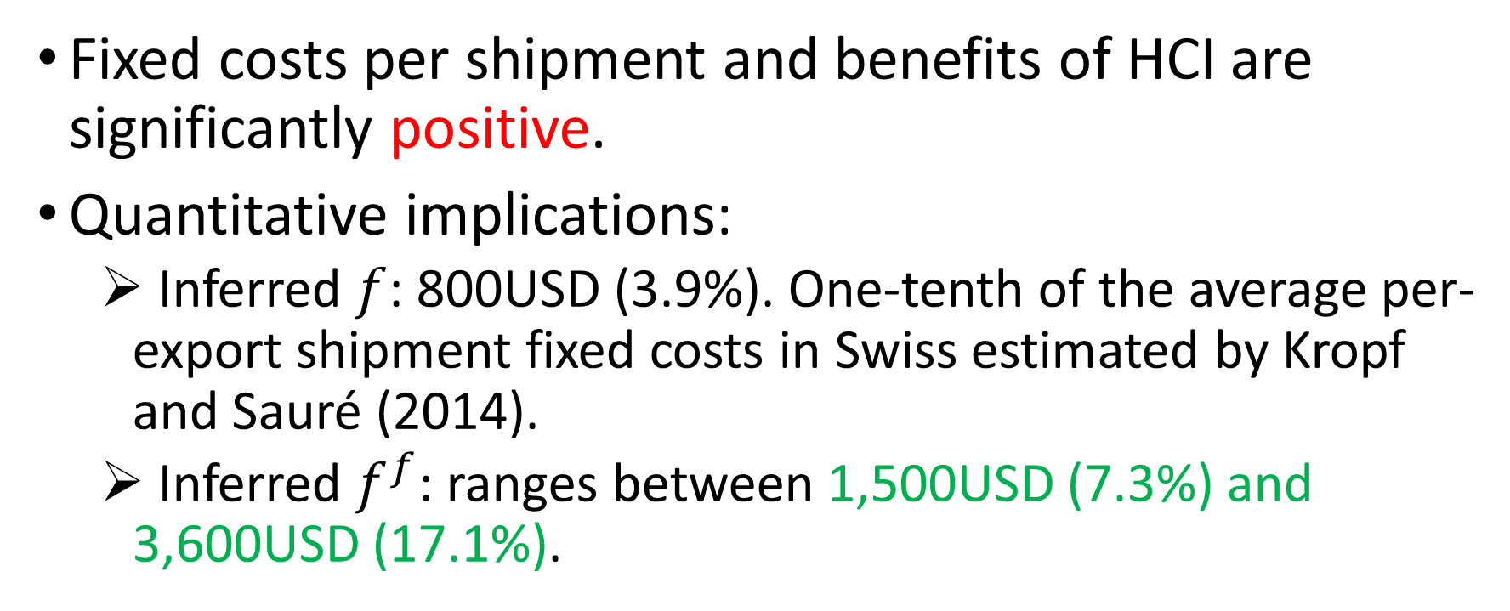
Benefits of HCI
Fixed costs per shipment and benefits of HCI are significantly positive.
Quantitative implications:
  Inferred $f$: 800USD (3.9%). One-tenth of the average per-export shipment fixed costs in Swiss estimated by Kropf and Sauré (2014).
  Inferred $f^{f}$: ranges between 1,500USD (7.3%) and 3,600USD (17.1%).

Slide 33
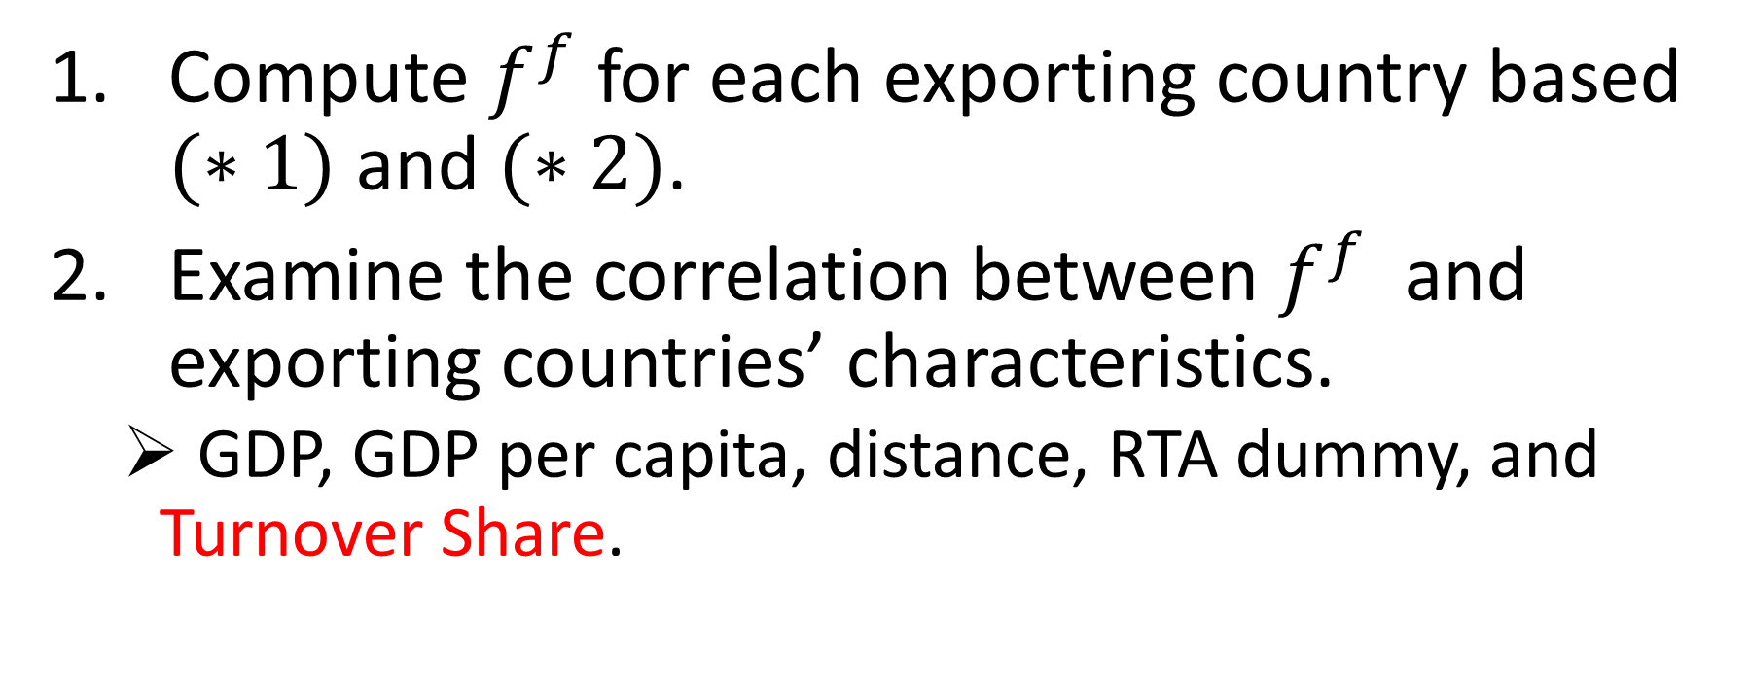

Determinants of $f^{f}$
Compute $f^{f}$ for each exporting country based $(∗1)$ and $(∗2)$.
Examine the correlation between $f^{f}$ and exporting countries’ characteristics.
  GDP, GDP per capita, distance, RTA dummy, and Turnover Share.

Slide 34
Table 11. Correlation of Fixed Costs for FCI Management with Export Country Characteristics

Slide 35
7. Conclusion
Benefits of HCI in imports are positive, and range btw 7.3% and 17.1% of value per shipment.
Those benefits are negatively correlated with Turnover Share of export country’s currency and RTA dummy.
Just-in-time orders with high frequency and small value per shipment are associated with HCI.

